Slide 1
Topic: Measurement EQ: How do I to convert units of measurement?
Year 11 Essentials

Slide 2
Things Required For This Lesson
Interactive Notebook
Textbook: Interleaved Maths Essential Connections
Ruler, Red Pen, Pencil, Pens, Scientific Calculator
Growth mindset

Slide 3

24
7
30
Topic: Measurement
EQ: How do I to convert units of measurement?
WICOR
This Photo by Unknown Author is licensed under CC BY-SA

Slide 4
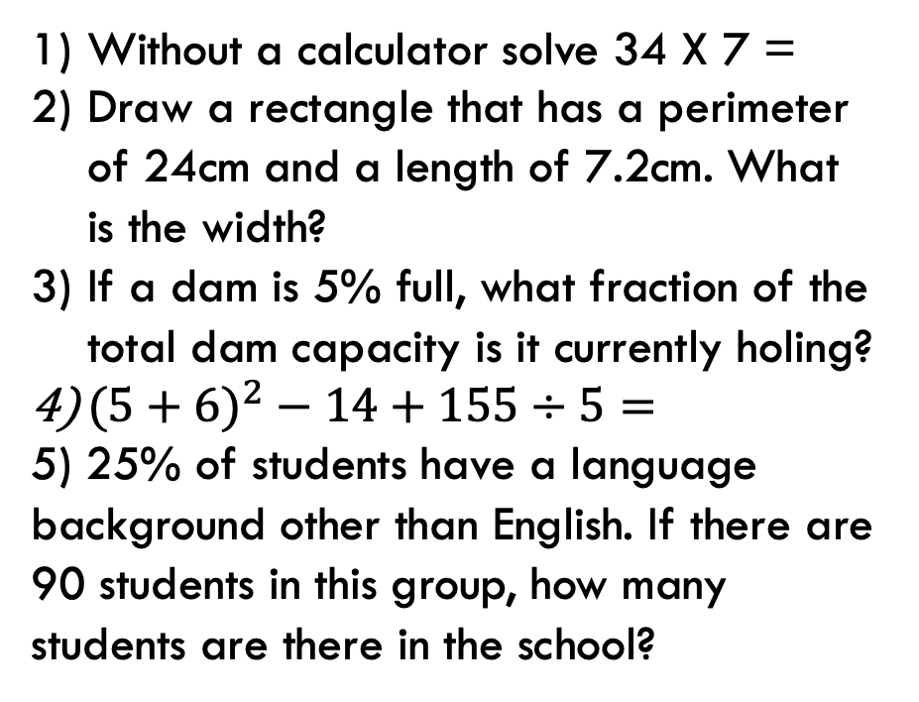
First 5
Answers
1) 238
2) 4.8cm
3) 1/20
4) 130
5) 360
Without a calculator solve 34 X 7 =
Draw a rectangle that has a perimeter of 24cm and a length of 7.2cm. What is the width?
If a dam is 5% full, what fraction of the total dam capacity is it currently holing?
$(5+6)^{2}−14+155÷5=$
5) 25% of students have a language background other than English. If there are 90 students in this group, how many students are there in the school?

Slide 5
24
7
30
Topic: Measurement
EQ: How do I to convert units of measurement?
Task:
With a measuring tape, measure the lengths of the following objects. Record the lengths in cm, mm and m.
Describe any patterns that you can see.
Object | Meters | Centimeters | Millimeters | What pattern can you see?
Desk Length
Room Length
Pencil Length
WICOR

Slide 6
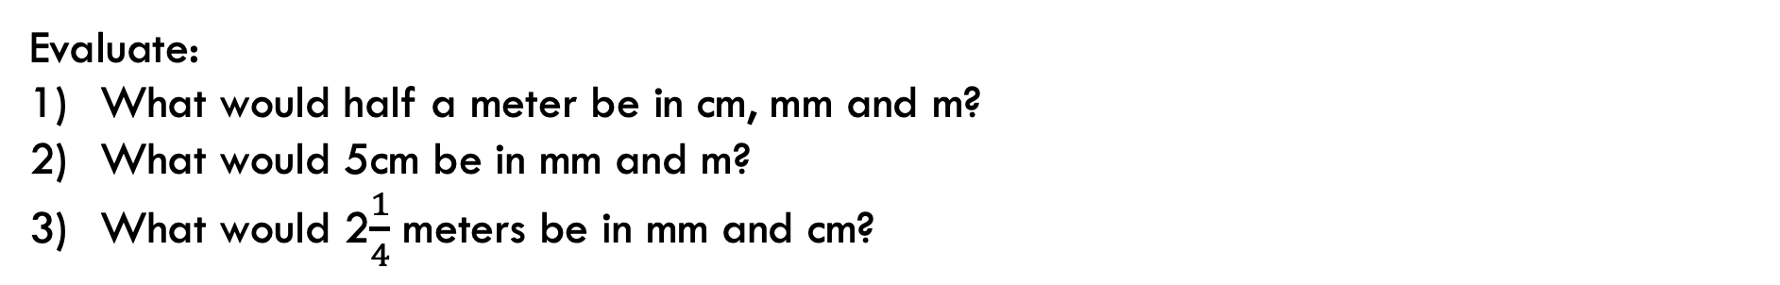
24
7
30
Topic: Measurement
EQ: How do I to convert units of measurement?
Evaluate:
What would half a meter be in cm, mm and m?
What would 5cm be in mm and m?
What would 2$\frac{1}{4}$ meters be in mm and cm?
Quickwrite:
Describe the relationship or pattern between meters, centimeters and millimeters.
WICOR

Slide 7
24
7
30
Topic: Measurement
EQ: How do I to convert units of measurement?
Measurements use the same base-ten system as place value.
-We can use place value chart to help convert between units.
The base unit has no Prefix (ones). Prefixes tells “how many”
The decimal shows where the ones are.
The prefixes for meter is kilo, centi, milli.
Review: Meter is the base unit.
1km = 1000m
1m = 100cm
1cm = 10mm
WICOR

Slide 8
24
7
30
Topic: Measurement
EQ: How do I to convert units of measurement?
The Place Value Chart below shows 2m converted into cm, mm and km. The decimal point moves from the original unit (m) to the converted unit for each case.
Length in a Place Value Chart
 | Thousands | Hundreds | Tens | Ones. | Tenths | Hundredths | Thousandths
 | Kilometers |  |  | Meters |  | Centimeters | Millimeters
m |  |  |  | 2.
cm |  |  |  | 2 | 0 | 0.
mm |  |  |  | 2 | 0 | 0 | 0.
km | 0. | 0 | 0 | 2
WICOR

Slide 9
Page 61
Complete Set A, B and C in your text books. Using the Place Value Table.

Slide 10

Thank you
Keep up the good work!
Quote of the day – ”Be like a postage stamp. Stick to a thing until you get there.”

